Slide 1

ALGORITHMS VISUALIZER
Shane Parmar
Sai Shravya Garlapati Deeksha Dubey

Slide 2
Abstract
Over the years we've observed that algorithms being a complex subject is the foundation of computational thinking and programming skills of a student. So, to ease up the hardships of students this idea of the project was formed.
Our application Algorithm Visualizer is both interactive and alluring to students. It gives the students hands on experience of the algorithms' implementation. It feeds into their imagination to help them get a better understanding while also helping teachers to help make their students understand better. This interface is designed to make one feel fully engaged and concentrated. We have made use of React.js as framework and JavaScript as primary language for our project.
The purpose of this project is to make learning less of a burden and more of an incredible experience which leaves students with the want to learn more.

Slide 3
Motivation
When we talk about complex subject topics like Algorithms, it becomes extremely necessary for students to have a strong grip over the topic as it would form the foundation of their computational thinking and programming skills.
We had observed that through conventional methods of teaching it becomes a little difficult for students to understand the concept and for teachers to explain their thoughts.
Motivated by the age-old saying, “a picture speaks more than thousand words”, many researchers and educators assume that students would learn an algorithm faster and more thoroughly using algorithm visualization techniques

Slide 4
INTRODUCTION
Algorithms that are included in the project are:
Searching Algorithms
- Linear Search
- Binary Search
Sorting Algorithms
- Bubble Sort
- Selection Sort
- Insertion Sort

Slide 5
INTRODUCTION CONTD..
- Quick Sort
- Heap Sort
- Merge Sort
Path Finder Algorithm
N-Queens Algorithm

Slide 6
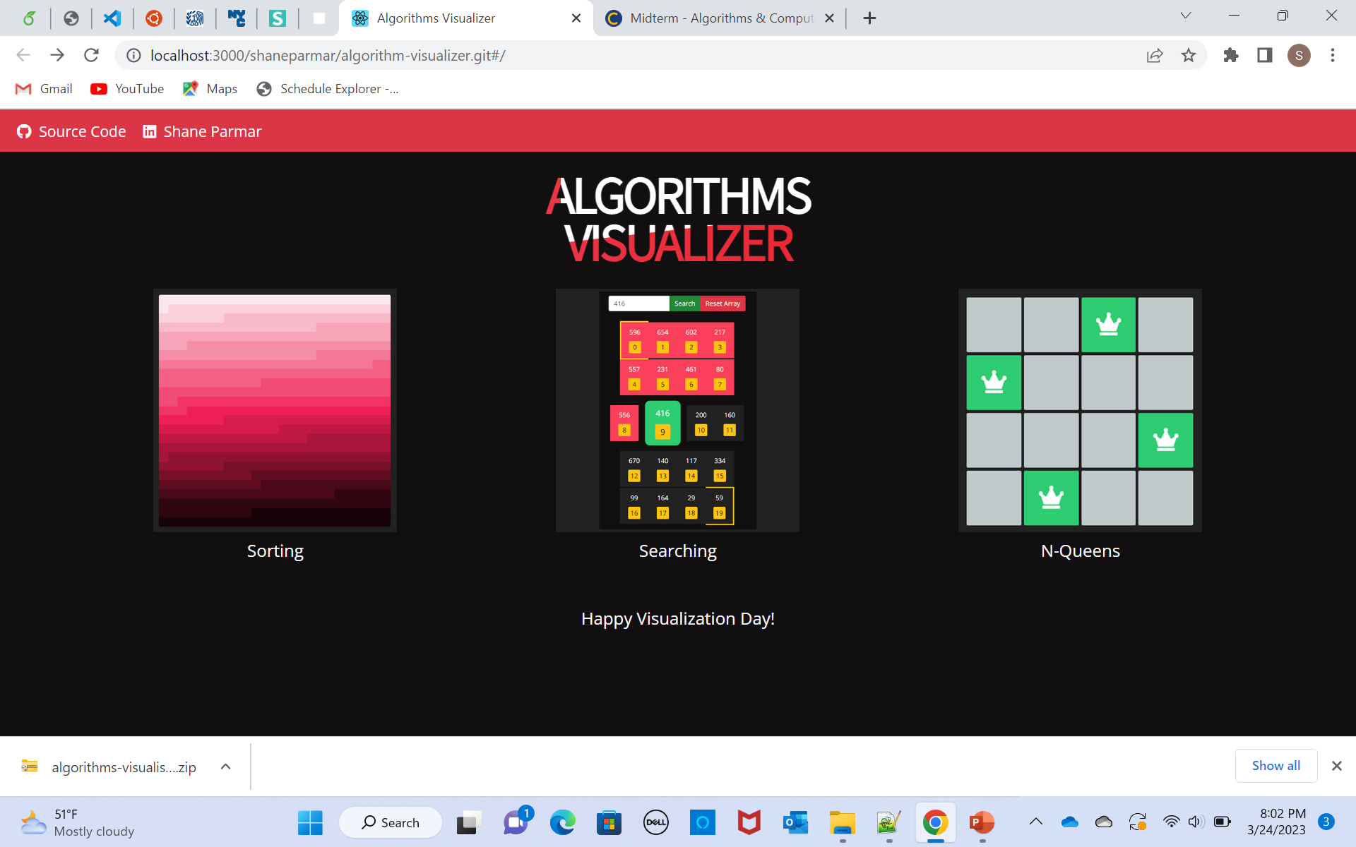
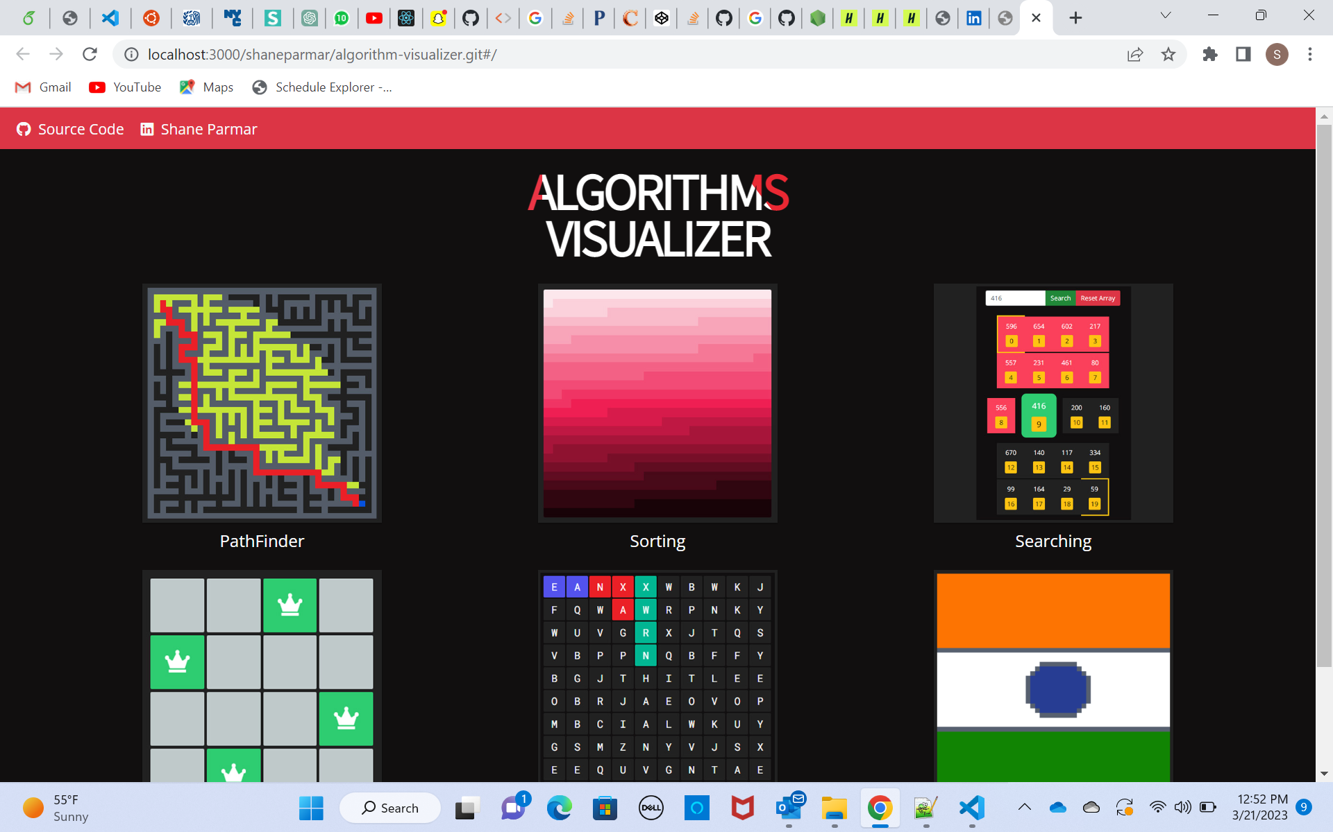
INTRODUCTION CONTD..
Main Page:

Slide 7
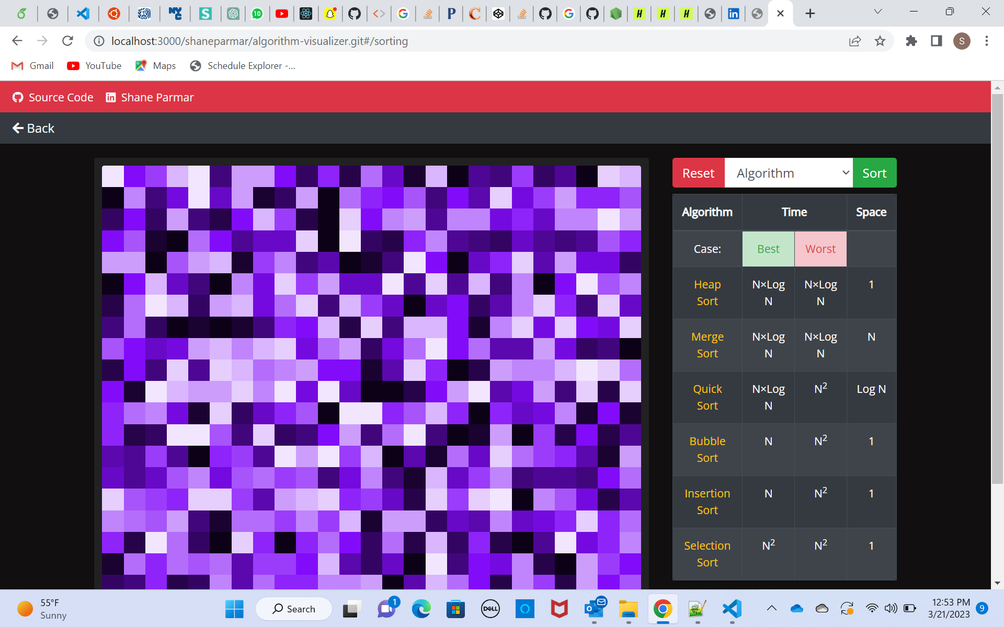
INTRODUCTION CONTD..
Sorting Page:

Slide 8
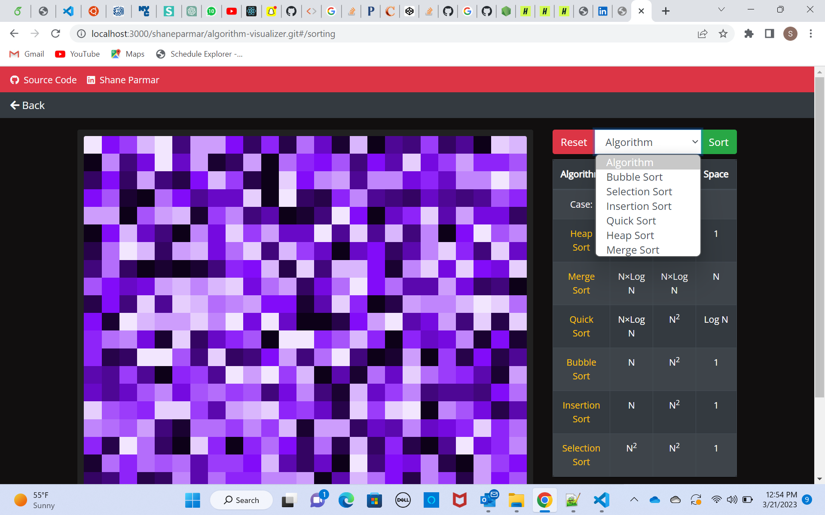
INTRODUCTION CONTD..
Sorting Dropdown:

Slide 9
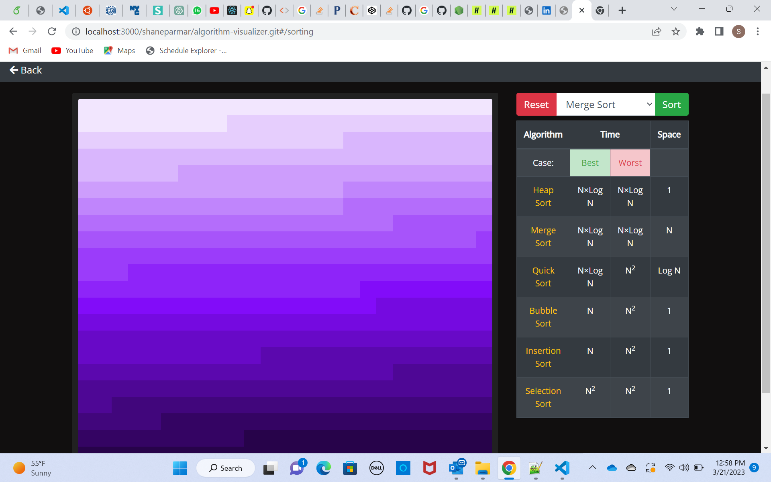
INTRODUCTION CONTD..
Merge Sort:

Slide 10
Conclusion: We have implemented algorithm visualizer for people to visualize, understand and imagine algorithms with ease.
THANK YOU!

